Slide 1
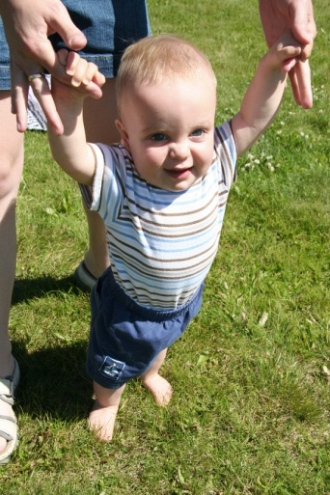
“Children witnessing violence in the home suffer serious cognitive, behavioral, emotional and developmental impairments which significantly alter their lives.”
(Jaffe, 1990)
Notes:
Slide on screen before presentation begins

Slide 2
New and Different Ways of Supporting Children in Shelter
Carolyn Goard Director of Member Programs and Services
Canadian Network of Women’s Shelters and Transition Houses Collaborating, Educating and Innovating to Shape Our Future Montreal Sept 17-19, 2012
Notes:
Introduce yourself

Slide 3
Alberta Council of Women’s Shelters (ACWS)
43 sheltering organizations
Support shelters and leverage collective knowledge to inform solutions to end DV
First world conference of women’s shelters
Founding partner: Canadian Network and the Global Network
Abused women and their children
Notes:
ACWS is almost 35 years old.
100% of domestic violence shelters in the province are our members – 43 organizations
Diversity of members shelters: emergency, second-stage (+ third stage), seniors, on-reserve
We exist to support shelters and leverage the collective knowledge to inform solutions to end DV.
We organized the first world conference of women’s shelters in 2008
We are a founding member of the Canadian Network of Women’s Shelters and Transition Houses and the Global Network of Women’s Shelters.
We are currently the fiscal agent for both networks
We administer the annual Global Shelter Data Count, the outcome of which each year is a powerful advocacy tool
- Focus: Abused women and their children.

Slide 4
The Literature
Notes:
All of our projects are based in and backed up by literature and practice.
For the our three children’s projects, some of these sources are….

Slide 5
Getting to Know You
Notes:
Audience introductions
Why are they here / hoping to gain from session

Slide 6
Collaborative Learning Endeavors
ACWS Core Values
- Definition
Notes:
ACWS’ Goals and Core Values: -serve as collective voice, foster networking & information sharing, assist in acquiring adequate resources for member shelters,
- influence public policy and systems, increase public awareness and foster professional development within the sheltering movement.
Ultimately, improving services for women and children
How we’re working together in Alberta
Collaborative learning endeavors defined
What are the learning practices, principals and outcomes in collaborative learning

Slide 7
Three Projects
Walking the Path Together
Helping Hands Project
Children’s Project
Notes:
Here are three projects within this particular focus area that each offer something unique.
ACWS currently has three action children-focused programs that offer a new take on helping children through shelters.
These are…

Slide 8
Collaborative Learning
Flex: unique circumstances each individual shelter
Implementation / Support
Meet
Evaluate
Notes:
Each of these projects integrate a collaborative learning model….
(four points above)

Slide 9
Walking the Path Together
Five on-reserve shelters
7-year old children
Eagle Feather Workers
Partners
Unique holistic interventions
2-year pilot
NCPC / Safe Communities
Notes:
Collaborative learning approach – appreciative inquiry – shelter directors and EFWs sharing their learnings; also Outcome Tracker data as above
The complexity of the client group – its not just the 7 year-old child but its also their siblings, parents and extended families that are involved; also complexity from the perspective of multiple issues/history the families come with
The nature of the job – working in remote locations, working on reserves, this is a 24/7 job – multiple and varied services provided in order to work with all families – doing whatever it takes
One of the project results - the manual that will be used to disseminate the learnings from this project worldwide and inform future implementation efforts
Finances and stress associated with addressing basic needs such as housing etc impacted families’ engagement and progress in the project
Overall outcomes positive and wide-ranging – see most recent report (most recent draft attached) – addressing issues such as domestic violence and abuse, cultural linkages, employment/housing/basic needs, child custody, school involvement, drug/alcohol use, criminal involvement and health

Slide 10
Walking the Path Together

Slide 11
Walking the Path Together
Sharing stories
Notes:
Nora-Lee Rear is the Executive Director of the Eagle’s Nest Stoney Family Shelter in Morley, Alberta which is on-reserve west of Calgary.
Eagle’s Nest is one of the participating shelters on Walking the Path Together, and Nora-Lee has agreed to share a story from the frontlines on the project.

Slide 12
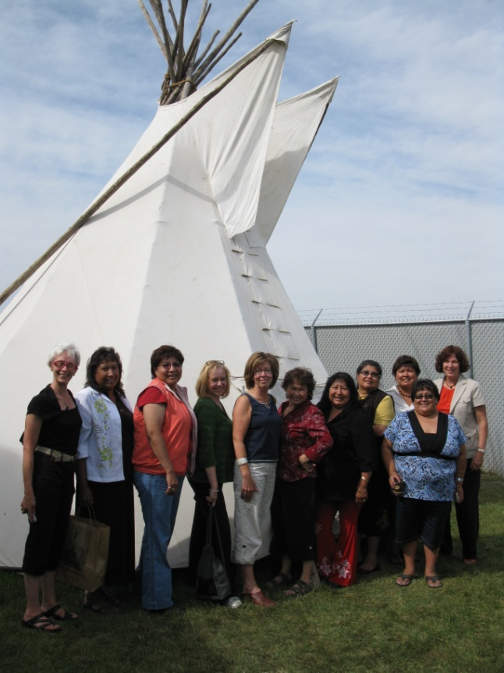
Walking the Path Together
- Collaborative Learnings
- Next steps
Notes:
Project Guidance Circle
Cultural competency
Adapting tools
Organic interventions
Partnership Considerations
Shelter staff vs. Project staff
Data Collection
Pilot was extended for another 18 months, which we recently announced at a media event in Edmonton. - Both NCPC and Safe Comm are funding this extension.
Data Collection

Slide 13
Helping Hands
Edmonton-area shelters
Pre-school aged children
Sharing a child-psychologist
Play-therapy
Notes:
Stollery Foundation funds second year of Helping Hands project; 1st year evaluation completed; and evaluation framework developed for second year;
Over the last 8 months (October 2011- June 2012), the therapist conducted three-hour weekly visits at each shelter and provided attachment-based interventions to mothers and children (see Appendix C for breakdown of the therapists’ hours). The nature of the services delivered by the therapist for Year 2 varied from year one. In year two, the therapist focused on engaging and supporting mothers in understanding the impact of domestic violence on their children and improving their parenting techniques in order to achieve healthy attachment with their children. The therapist also provided mentorship to shelter staff and made an effort to help staff integrate the project into shelter programming. In Year 2, the therapist collected and analyzed data from participating children, mothers and shelter staff to evaluate the impact of the project on participants. ACWS collected data from shelter executives and staff in order to evaluate the overall impact of the project from the shelters’ perspective.
Provide Access to a child psychologist for pre-school children in Edmonton’s woman’s Shelters
Improve Edmonton shelter worker capacity
Establish a program model to support and inform practice in Alberta

Slide 14
Helping Hands
Thera-play video here?

Slide 15
Helping Hands
- Sharing stories
Notes:
The Edmonton Woman’s Shelter (A.K.A. “WIN HOUSE”), is one of the participating shelters on the Helping Hands project.
Janine Fraser, Executive Director of Win House, is here to share a Helping Hands story.

Slide 16
Helping Hands
Collaborative Learnings
Next Steps
Notes:
Learnings
Lesson 1: Each shelter context is different and therefore a ‘one size fits all’ model is not appropriate for early childhood interventions. A model must be flexible in order to be effectively integrated into shelters.
Lesson 2: Having an external therapist delivering interventions appears to be more effective than training shelter staff to deliver therapies. The expertise that a therapist brings to intervention is invaluable and cannot be taught to shelter staff through in-services. Further, shelter staff are already working at full capacity, making it very difficult to add another role to their work. Having an external therapist come and work with mothers appeared to be an important aspect of the success of the project.
Lesson 3: For successful integration into shelter work, shelter staff require training and mentorship from the acting therapist. This training and mentorship allows shelter staff to provide more seamless support to mothers and children while in shelter. Case conferencing is also an important aspect to successful integration of shelter services for mothers and children. When staff are both aware of the work the therapist is doing and understand this work, they are able to better support the therapists’ work and continue it when the therapist is gone or sessions have ended.
Lesson 4: In order to engage in therapy, mothers and children need to have their basic needs met. Shelters should continue to advocate for funding such as Making Amends, that provide financial support to meet the immediate needs of women and children fleeing domestic violence.
Lesson 5: External therapists need to recognize the often chaotic nature of communal living in a women’s emergency shelter and adjust the activities accordingly. Lack of space in women’s shelters compounds this difficulty. In one emergency shelter, in year 2, the therapist engaged women in the eating area, which reduced perceived barriers of approaching a therapist.
Lesson 6: The Interdisciplinary Training sessions that were held to acquaint the Family Centre and shelters with their respective work was very helpful in establishing an appreciation and shared understanding for the work of the respective organizations.
Lesson 7: The amount of staff time and ACWS support was greater than anticipated and not budgeted.
Next Steps (?)

Slide 17
Children’s Project
12 participating shelters
Dr. Dawn Clarke of Mount Royal College
Curriculum & training sessions
Notes:
-Children’s Curriculum developed, two training sessions held (April and September 2011)and project with 12 shelters participating commenced in October 2011. 8 project leadership team meetings held; bimonthly contact by clinical consultant with all child support staff – individual and group consult Emphasize the overall focus of the project on integrating the child support work into daily shelter operations. This was a demonstration project that allowed us to determine what barriers might exist in doing this.
The key barrier here was the nature of emergency shelter work and encouraging women to participate while in crisis – so in the course of the project we came up with a number of different solutions and the introductory group sessions was a particularly valuable way to engage moms and integrate project into shelter operations
Importance of support that ACWS provided – to help with respect to clinical work, but also data tracking and management.
Collaborative learning – the leadership group engaging the directors to share their learnings and the child support group engaging staff and providing clinical support; also using Outcome Tracker data to inform service provision
Even though the participation was low (I think we have 25 children now, but Susan can confirm that), women who did take part are very positive about the program (see interview summary for confirmation).
Can also use the most recent Children’s data summary (attached) to describe the diversity of client groups, their involvement in the project and the parenting stress most moms in the project experienced. I would not use the outcome data from that report – very preliminary.

Slide 18
Children’s Project
Video?
Notes:
Share Training DVD here

Slide 19
Children’s Project
Sharing stories
Notes:
Nora-Lee Rear

Slide 20
Children’s Project
Sharing stories
Notes:
Nora-Lee Rear

Slide 21
Children’s Project
Collaborative Learnings
Next Steps
Notes:
Learnings (?)
Better understanding of the impact abuse has on children
Moms noticed that their children were “closing up”, “shy” and seemed withdrawn or were angry and easily frustrated.
Moms did not realize before their involvement in the project how much abuse affected their children. Some thought that because they left the abusive relationship their children would be fine. Some moms did not realize that their children would be impacted if they witnessed and did not experience abuse. Some thought that young children don’t remember the abuse and so are not impacted by what is happening to them.
Moms are now understanding how abuse can frighten and impact children and realize that the abuse can have an impact “down the road”.
One mom said that she did not learn anything about the impact of abuse from the worker assigned to the project, but did from the other counsellors at the shelter.
Closer, more trusting relationship between mother and child
Participation in project created “more bonding”, the “connection” between mother and child is stronger.
There is “more trust” between the mother and child; children learn that mom will always be there “to catch them”
The sessions helped lower the stress between mom and child.
Mother and children have fun together, mothers “enjoy their children more”, “enjoy playing games together”.
One mom thought that as a result of her daughter’s participation in the Children’s Project her daughter is more comfortable being away from her for short periods of time.
Some moms (n=3) did not think the project has had an impact on the relationship with their children because “they had always been close”, but one of them stated that “you can never be too close to your child”.
Better understanding of their children’s behaviours
Project helped moms “understand children’s behaviours better” and know that some of “acting out behaviour is a result of the abuse children witness” (e.g., anger, temper tantrums and yelling).
Moms are also reporting that the project helped them learn how to discipline their children in a “healthy way”. They take time to observe their children so that they can see the signs that the children might be upset.
Moms understand the importance to let children “go at their own rhythm” and are now “more patient” with their children.
Moms now understand the importance of spending time together and to give their children the attention they need.
Some moms now understand the importance of routines and are incorporating structure into their days with their children.
A weekly play group that was part of the project helped one mom feel more confident about her role as a parent and understand that “isolating herself and her child is not a good thing to do”.
Impact of project on children’s behaviours
Impact of the sessions was immediate – mothers observed changes in behaviour very quickly.
Mothers see less anger and frustration in their children.
Children are communicating their feelings to their mothers more often (e.g., feeling cards helpful in this regard) “it is neat to see him use words to describe his emotions”.
Children are “no longer hiding”, starting to talk, interact with other people, and do better in school.
The project helped the child become “more responsible, cooperative and less demanding”, responding better when there are limits set.
Value of play activities
Moms and children all had several favourite activities that they could identify. After engaging in those activities they realized how important it was to have focused time with their children.
One mom emphasized the value of imaginary play: they now engage in imaginary play and have lots of fun doing that together.
Both mothers and children looked forward to their weekly program sessions.
All mothers who were interviewed identified several activities that they are already using when alone with their children.
Important elements/areas for improvement
Some mothers did not understand the purpose of the project and why they and their children were involved. They would have liked more information.
One mother would have preferred for shelter staff “who had a history with her” rather than a child support worker she did not know to work with her and her child.
Some mothers highlighted the importance of having the activities that are well-planned and to have a snack during the play session.
One mom suggested adding activities that are soothing and calming for those children who are “very spirited”.
Some moms thought that the activities in the playroom were better suited for older children (two and half years and up).
Some moms would like to see more variety in the activities, so that they don’t have to “do the same thing every week” (although same mother indicated that the routine of the activities might also be beneficial)
The Children’s project may have less impact in cases where children come with additional concerns, e.g., ADHD, FASD or a more complicated situation. In those instances it is important that the family is linked with external mental health supports or a child therapist.
Overall feedback
Mothers thought that any child that has been impacted by abuse would benefit from participating in the Children’s project.
Mothers now understand that it is “important to heal the children so that they will get better”
“The staff are doing an excellent job”.
“I would recommend the Children’s Project for anyone that wants to have a closer bond with their child …it really works”.
Next Steps (?)

Slide 22
Our Work
Contribute
Efficacy
Direct Approach
Evolve
Notes:
Contribute to promising practice knowledge to advocate for more support.
Data collection, demonstrate efficacy of work
Working with moms and children directly
Our evolution of understanding

Slide 23
Discussion
Notes:
Questions?
Would anyone like to share their own unique children’s progamming?
What challenges have you met in creating interventions for children?

